Slide 1
All Systems Go!
Python with Robots Mission 9
Lesson 1 Objectives 1-4

Slide 2

Pre-Mission Warm-Up
In your Mission 9 Lesson 1 log, answer the pre-mission warm-up questions:
What are some sensors on CodeBot you know how to use?
What other information from a CodeBot sensor would you like to have access to?

Slide 3

Mission 9: All Systems Go!
In this mission you’ll get to know CodeBot’s internal system sensors.
Your ‘bot can measure its own battery voltage and CPU temperature.
And it can sense its orientation as well as impacts and vibration with the accelerometer.
Ah yes, CodeBot is self-aware!

Slide 4
Mission 9: All Systems Go!
For this lesson, we will work on the first goal:
Code a battery tester so you can tell how much fuel is left in your bot’s tank.
Robot, know thyself!

Slide 5

Objective #1: Battery Check
When it comes to monitoring the state of your hardware, battery level is one of the most critical items to track.
CodeBot’s system sensors give your ‘bot the tools to monitor its battery voltage.
Understanding how the sensors work is the first step to figuring out how much “fuel” is left in your bot’s tank.

Slide 6
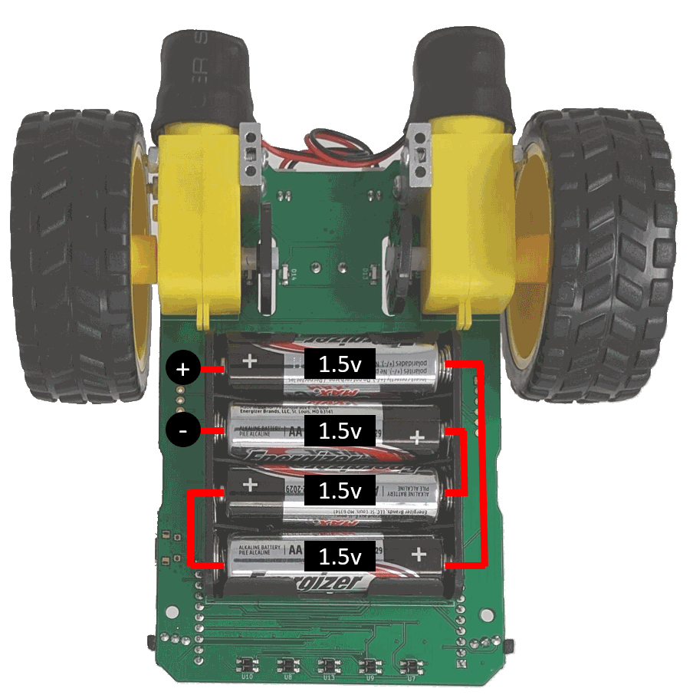

Objective #1: Battery Check
Typical AA alkaline batteries provide 1.5 volts per cell when fresh.
CodeBot has 4 batteries in series, wired as shown.
Voltages in series add, so the total voltage of brand-new batteries is:

Slide 7
Objective #1: Battery Check
As batteries use up their capacity, their voltage decreases.
Due to battery chemistry, you’ll see the full drop in voltage only when the batteries are under load.
This means they are doing something, like lighting up LEDs or running motors.

Slide 8
Objective #1: Battery Check
Concept: System Power Monitoring
The botcore library system has two functions that allow CodeBot to check the status of its power supply.
The power_volts() function returns a float for the power supply voltage.
It can come from the USB or from the battery pack.
This depends on the position of the power switch.

Slide 9
Objective #1: Battery Check
Concept: System Power Monitoring
Even when connected to the USB port, you can set the switch to BATT and draw its power from the battery pack instead of USB.
USB chargers typically supply about 5 volts.

Slide 10
Objective #1: Battery Check
Concept: System Power Monitoring
The power_is_usb() function returns 1 if the switch is in USB position and 0 if it is in BATT position.

Slide 11

Objective #1 Activity
Try the system functions in the console panel.
DO THIS:
Open the console panel.
Put the power switch to BATT.
Type these two commands:
What is the result? Record it in the mission log.

Slide 12
Objective #1 Activity
Try the system functions in the console panel.
DO THIS:
Put the power switch to USB.
Type these commands:
What is the result? Record it in the mission log.

Slide 13

Objective #1 Activity
Try the system functions in the console panel.
DO THIS:
Keep the switch in USB.
Type this command:
What is the result for voltage (no load)? Record it in the mission log.

Slide 14

Objective #1 Activity
Try the system functions in the console panel.
DO THIS:
Keep the switch in USB.
Type these commands:
What is the result for voltage (with load)? Record it in the mission log.

Slide 15

Objective #1 Activity
Try the system functions in the console panel.
DO THIS:
Keep the switch in USB.
Type these commands:
What is the result for voltage (no load)? Record it in the mission log.

Slide 16
Objective #2: Battery Tester
Knowing the battery voltage is nice, but what you probably want to know is how much battery life your ‘bot has left.
The chart on the next slide was made by a CodeBot.
The chart was made by checking pwr_volts() every 5 minutes for many hours, with all LEDs on, until the batteries died.

Slide 17
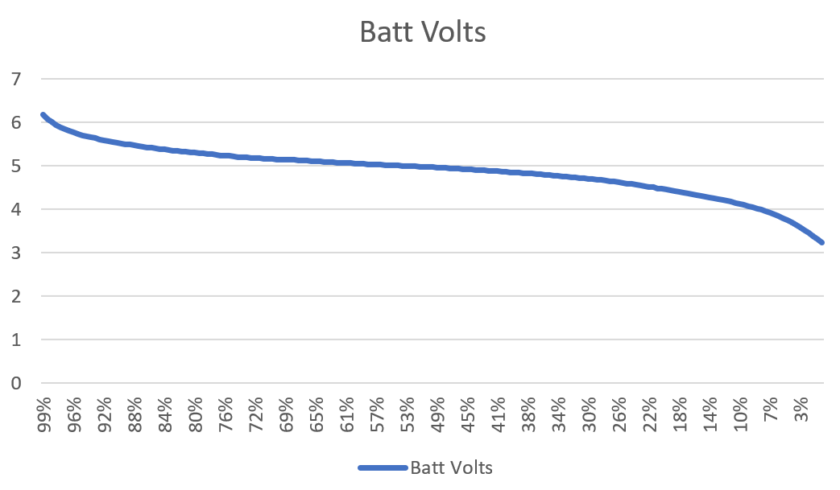
Objective #2: Battery Tester
The battery discharge curve is not a straight line.
But you can make a pretty good estimate of remaining capacity with just a few data points.

Slide 18
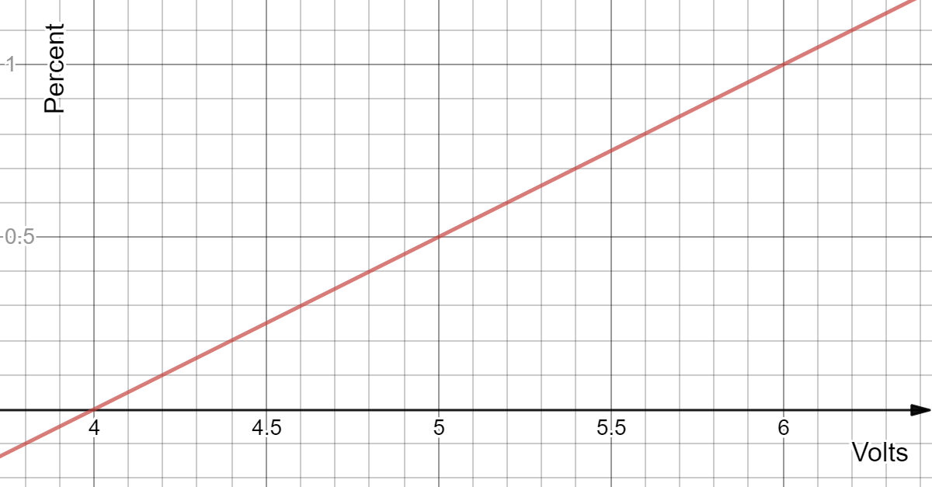
Objective #2: Battery Tester
To keep things simple, the chart shows a straight line between 100% and 0% levels.
Voltage | Capacity
6v | 100%
5.5v | 75%
5.0v | 50%
4.5v | 25%
4.0v | 0%

Slide 19
Objective #2: Battery Tester Algorithm
Write a function that measures and returns the battery voltage under load.
A suitable load is turning on 4 user LEDs during the measurement.
Write a function that converts the voltage to a float for percentage and then to the corresponding capacity.
Use the data from the chart on the last slide.
Print the input voltage and output (percent).
Write a main program that tests the functions.

Slide 20
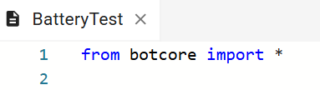
Objective #2 Activity
DO THIS:
Start a new file and name it BatteryTest.
Import the botcore library.

Slide 21
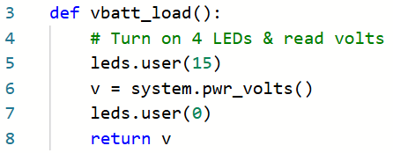
Objective #2 Activity
DO THIS:
Define a function that reads the volts under load.

Slide 22
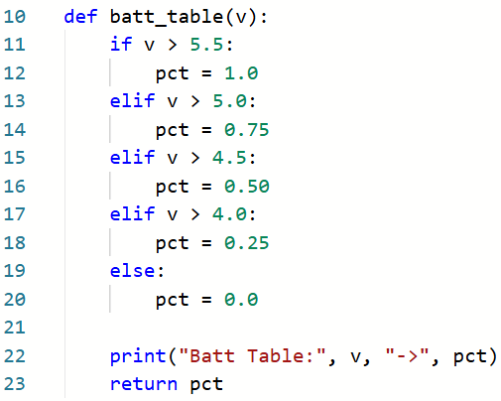
Objective #2 Activity
DO THIS:
Define a function that converts the voltage to a percent capacity.
Use the table from slide 18.
Print and return the percent (pct).

Slide 23
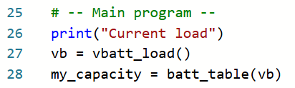
Objective #2 Activity
DO THIS:
Write the main program to call the functions and print the current voltage and capacity.

Slide 24
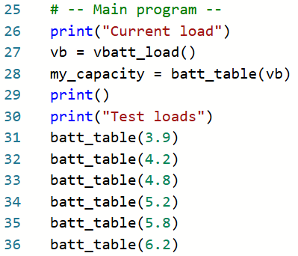
Objective #2 Activity
DO THIS:
Add test data to the main program.

Slide 25
Objective #2 Activity
DO THIS:
Leave the power switch set on USB.
Open the console panel.
Run the code.
Record the results of the current load on USB in your mission log.
Switch the power to BATT.
Run the code again.
Record the results for the current load on BATT.

Slide 26
Objective #3: Equations to the Rescue!
Rather than using a table, maybe a little math can help here!
You are approximating the battery voltage decrease as a straight line.

Slide 27
Objective #3: Equations to the Rescue!
The equation for a line is y = mx + b
For this line:
y is the percent
x is the voltage
m is the slope of the line, or ½
b is the y-intercept, or -2
So the equation of the line is: y = ½ ᐧ x ‒ 2
This can be simplified to:
percent = (volts / 2) ‒ 2

Slide 28
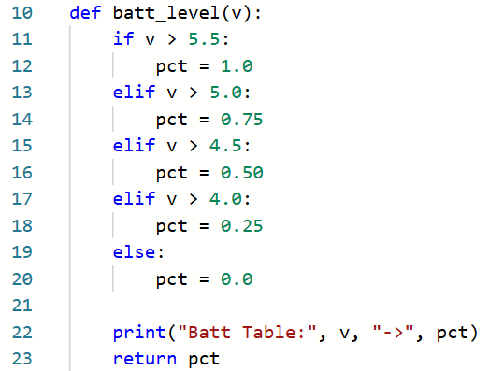
Objective #3 Activity
DO THIS:
Change the name of batt_table(v) to batt_level(v).
Delete the if statement inside the function.

Slide 29
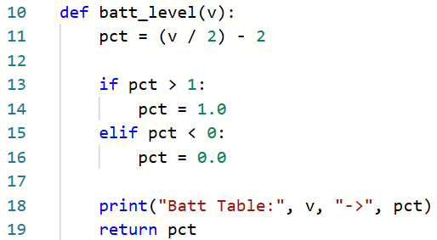
Objective #3 Activity
DO THIS:
Calculate the capacity (pct) using the equation of the line.
Add an if statement to keep the pct between 0 and 1.0

Slide 30
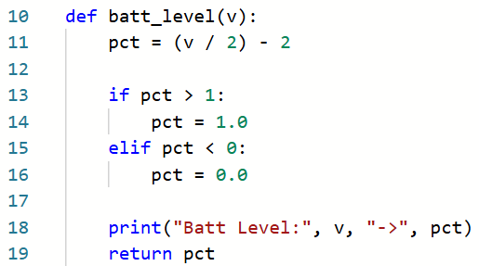
Objective #3 Activity
DO THIS:
Change the print statement to “Level” instead of “Table”

Slide 31
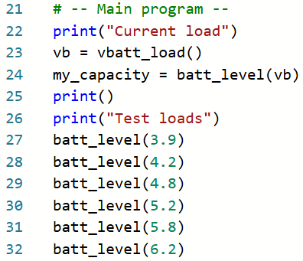
Objective #3 Activity
DO THIS:
In the main program, change all the function calls from batt_table() to batt_level().

Slide 32
Objective #3 Activity
DO THIS:
Put the power switch on USB.
Open the console panel.
Run the code.
Record the results of the current load on USB in your mission log.
Switch the power to BATT.
Run the code again.
Record the results for the current load on BATT.

Slide 33
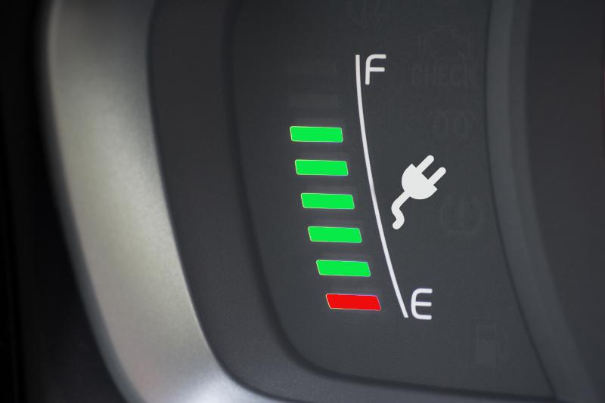
Objective #4: Battery Indicator Light
To polish off your battery tester you need a user interface that doesn’t require watching the console.
A user interface is a way for a person and machine to communicate.
On a computer, you can use a screen and keyboard.
On a robot, you can use the LEDs.

Slide 34
Objective #4: Battery Indicator Light
This step adds a useful function you can call when a program starts.
It can indicate to the user the battery health.
If the battery LED stays lit, it is a warning to change batteries soon.
One blink means the batteries are full.
Two blinks means they are used, but still healthy.

Slide 35
Objective #4: Battery Indicator Algorithm
Write a new function that:
Uses the returned value of pct to activate a special battery LED.
The red LED is just above the power switch.
Use leds.pwr(is_on) to turn on/off the LED.
Blink once if capacity is over 60%
Blink twice if capacity is between 20% and 60%
Leave the LED on if capacity is below 20%

Slide 36

Objective #4: Battery Indicator Algorithm
You will blink an LED, so you need to sleep() in between on and off.
Import sleep from the time library.

Slide 37
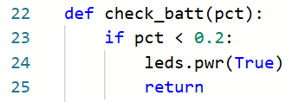
Objective #4: Battery Indicator Algorithm
Define a new function with pct as the parameter.
First check if the battery is below 20%.
If so, turn on the LED and keep it on.
Then “return” so the function stops and returns to the main program.

Slide 38
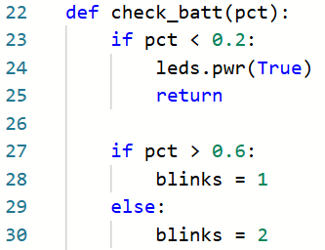
Objective #4: Battery Indicator Algorithm
The battery isn’t too low, so check if the battery is above 60%.
If so, assign blinks = 1
Otherwise the percent is between 20% and 60%, so assign blinks = 2.

Slide 39
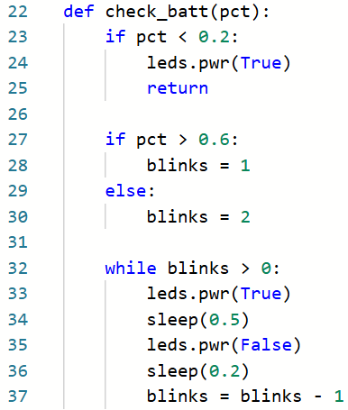
Objective #4: Battery Indicator Algorithm
Add code that blinks the LED, either 1 or 2 times.
Remember to decrement the variable blinks.

Slide 40
Objective #4 Activity
DO THIS:
Import the sleep function from the time library.
Define a function for check_batt().
Write the code, following the algorithm on slides 37-39.

Slide 41
Objective #4 Activity Code

Slide 42
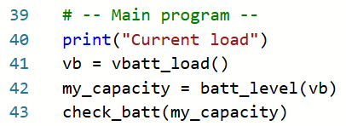
Objective #4 Activity
DO THIS:
In the main program, add a function call to check_batt().

Slide 43
Objective #4 Activity
DO THIS:
Open the console panel.
Switch the power to BATT.
Run the code.
Record the result in the mission log.
Switch the power to USB.
Run the code.
Record the result in the mission log.

Slide 44
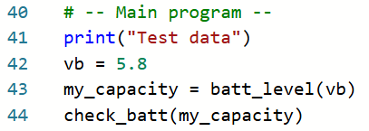
Objective #4 Activity
DO THIS:
Change the main program for test data.
The run the code again and record the results.

Slide 45
Objective #4 Activity
DO THIS:
Use the test case data in the table.
Run the code for each test case and record the results.
For the last test case, choose your own voltage.
Compare your results with other students.

Slide 46

Extension
Use the user LEDs as a battery indicator. Turn on all LEDs for full power, and decrease the LEDs as the calculated percent decreases. When all LEDs are off, the batteries are close to dead.

Slide 47
Post-Mission Reflection
Complete the post-mission reflection in your Mission 9 Lesson 1 Log:
How could you use the battery tester functions with other CodeBot programs?

